Slide 1
Cohort1 (AIML)
Life Expectancy

Slide 2
Agenda
To create an automation to bring R square value for various methods.

Slide 3
Data Summary (Life Expectancy Analysis)
193 countries participation
22 Factors (Columns)
15 years of data spread
Factors involved are:
Immunization
Mortality
Economical
Social
Name | Data Type
Country, Status, Year | Discrete
Other | Continuous
Note: We are following regression model as output “Life Expectancy” is a continuous type output.

Slide 4
Phases
Data Column Fixes
Missing Data Identification and Columns reduction
Data Correlation and Column reductions
Outliers and Data Normalization
Data Distribution Analysis
Write Script/Automation for full analysis with various methods

Slide 5
1a. Data Column Fixes
Summary:
Remove whitespaces from both ends
Replace underscore with whitespace in between [optional]
Replace all upper cases to lower cases for uniformity [optional]
Result: Get uniform and clean columns names

Slide 6
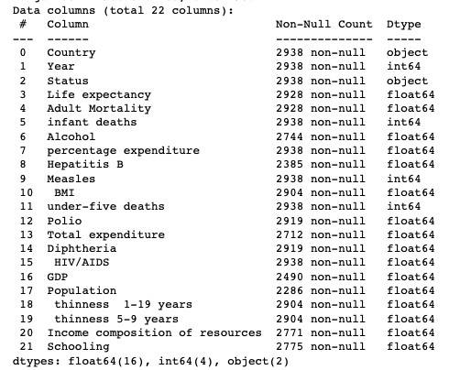
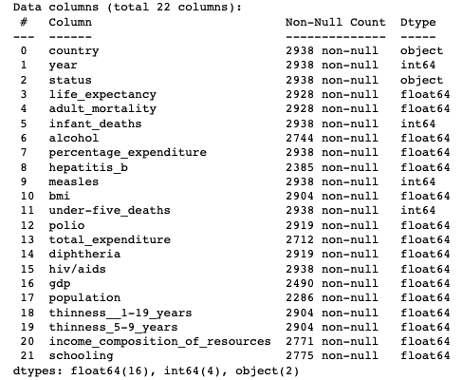
1b. Data Column Fixes
Before
After

Slide 7
2. Missing Data Identification
Summary:
29% data missing from Population column
23% data missing from Hepatitis B
18% data is missing from GDP
Result: Removed columns having high volume of missing data.

Slide 8
3a. Correlation of Data columns
Summary:
Infant deaths and under-five death have 0.99 correlation
Infant deaths are superset of under-five
Keeping “infant_deaths” for the spread
Thinness 5-9 years and Thinness 1-19 years have 0.93 correlation
1-19 is superset of 5-9
Keeping “thinness_1-19_years” data for spread
GDP vs percentage expenditure have 0.89 correlation
Keeping “percentage_expenditure” as GDP has big missing data chunk

Slide 9
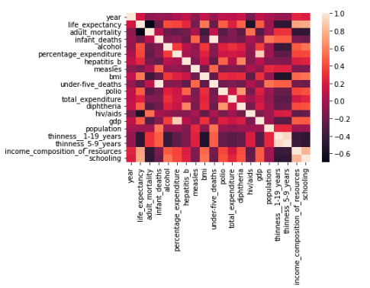
3b. Correlation by Visualization [Heatmap] (cont.)

Slide 10
4a. Outliers Identification and Imputation
Summary:
Data Point | Outlier Records (Count) | Outlier Records (%) | Method of handling
hiv/aids | 542 | 18.44% | Dropped the column
measles | 542 | 18.44% | Dropped the column
under-five_deaths | 394 | 13.41% | Fill in missing data
percentage_expenditure | 389 | 13.34% | Fill in missing data
infant_deaths | 315 | 10.72% | Fill in missing data

Slide 11
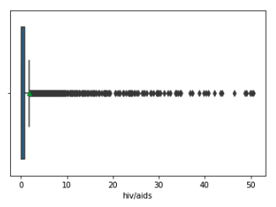
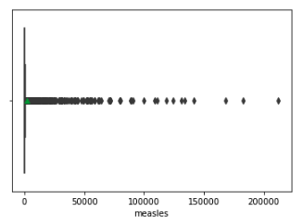
4b. Outliers by Visualization [BoxPlot]

Slide 12
5a. Data Distribution
Summary:
Identify data uniformity
Low Density [handled in previous step]
Too much diversity

Slide 13
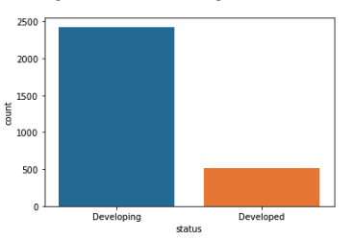
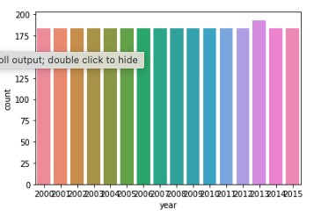
Data Distribution
Uneven Status Distribution
[Bar Plot]
Uniform Data Samples YoY
[Count Plot]

Slide 14
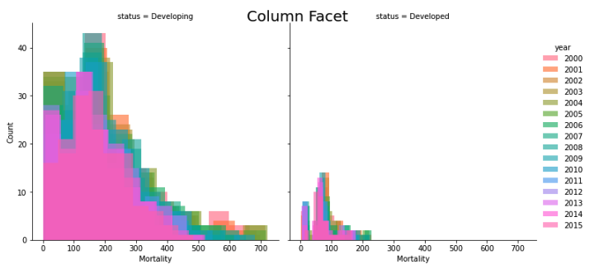
Data Spread/Distribution
Mortality rate was high and reducing over the years
[FacetGrid Plot]

Slide 15
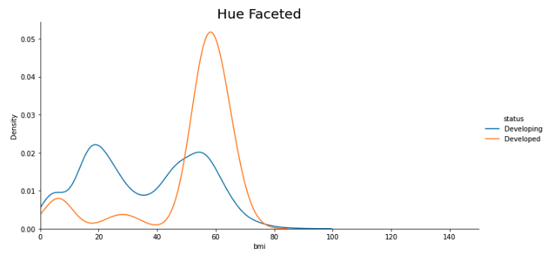
Data Spread/Distribution [FacetGrid Plot]

Slide 16
6. Script & Automation
– gr5regression.csv – Life Expectancy – [ “Country”, “Year”, “Status” ] – Prime Numbers between 1-500 – 4 – > 0.9 or < -0.9 – 10% of actual data – 10% of actual data – < 8 – > 5%
Script Config Parameters:
Input Data Path
Output Component
Discrete Components
Random State Values
KNN Imputer num of neighbors
Highly Correlation
Test Size
Acceptance % of empty data
Unique values count for One hot encoding
Outliers column Removal

Slide 17
6a. Methods Used in Script
Mode Or Median
KNN Imputer
Normalisation
Standardisation
PCA
Outliers Removal
One Hot Encoding

Slide 18
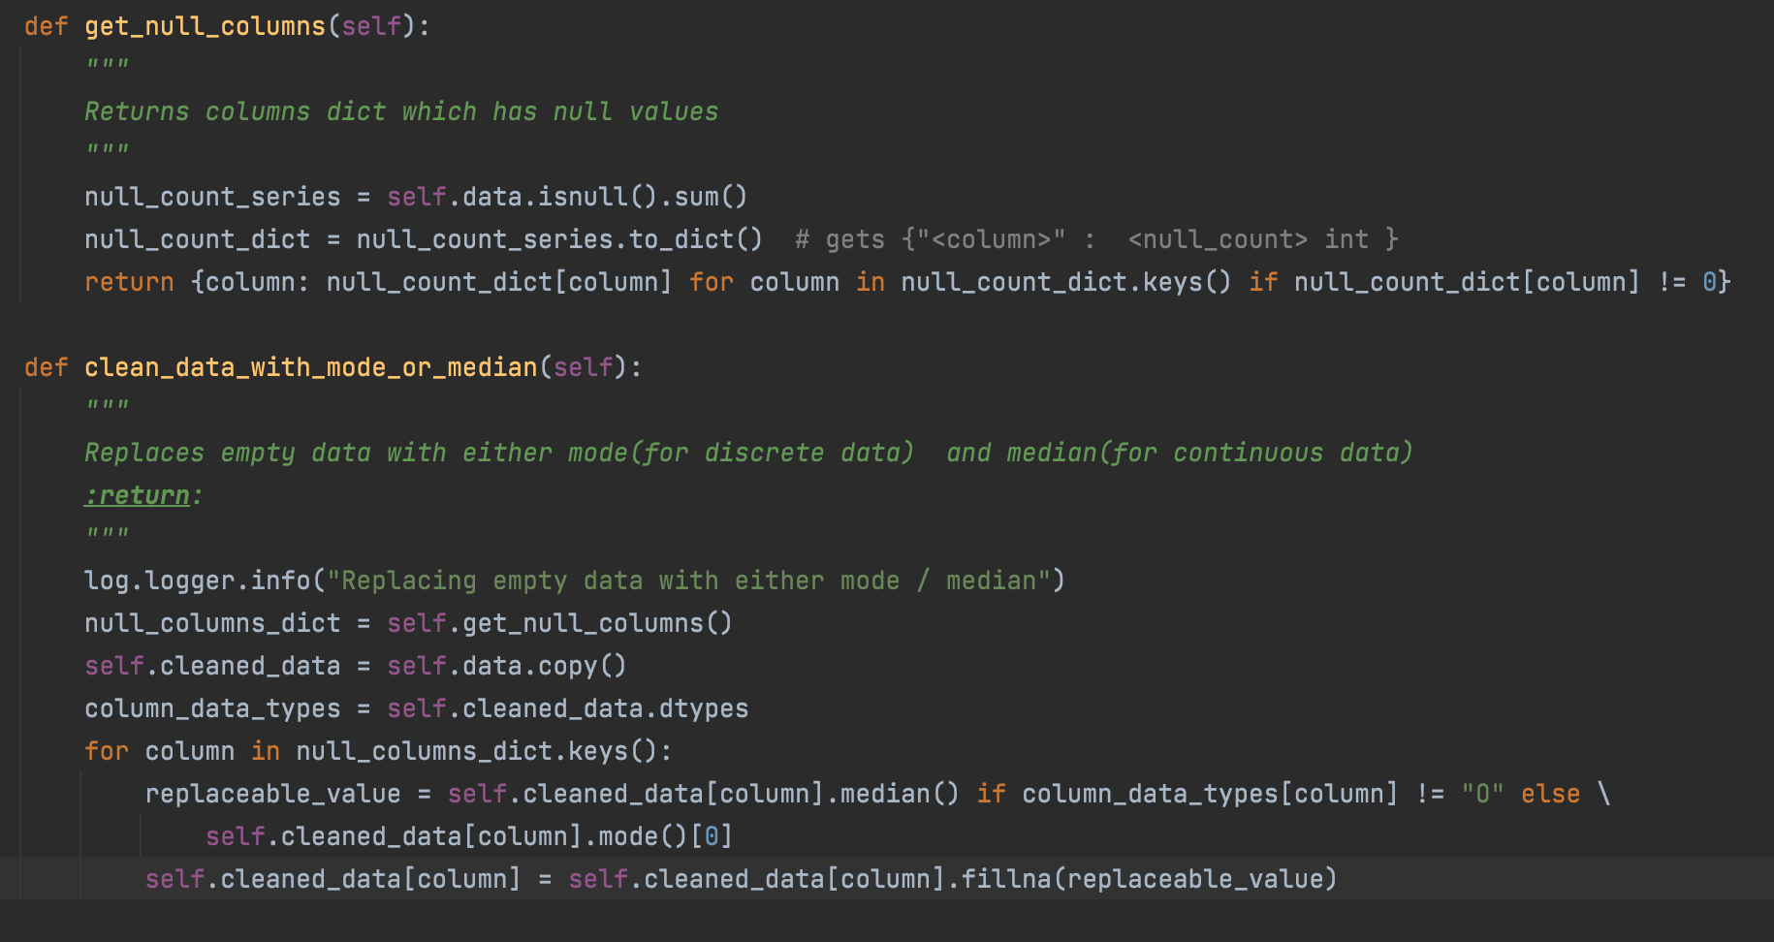
6b. Important Methods

Slide 19
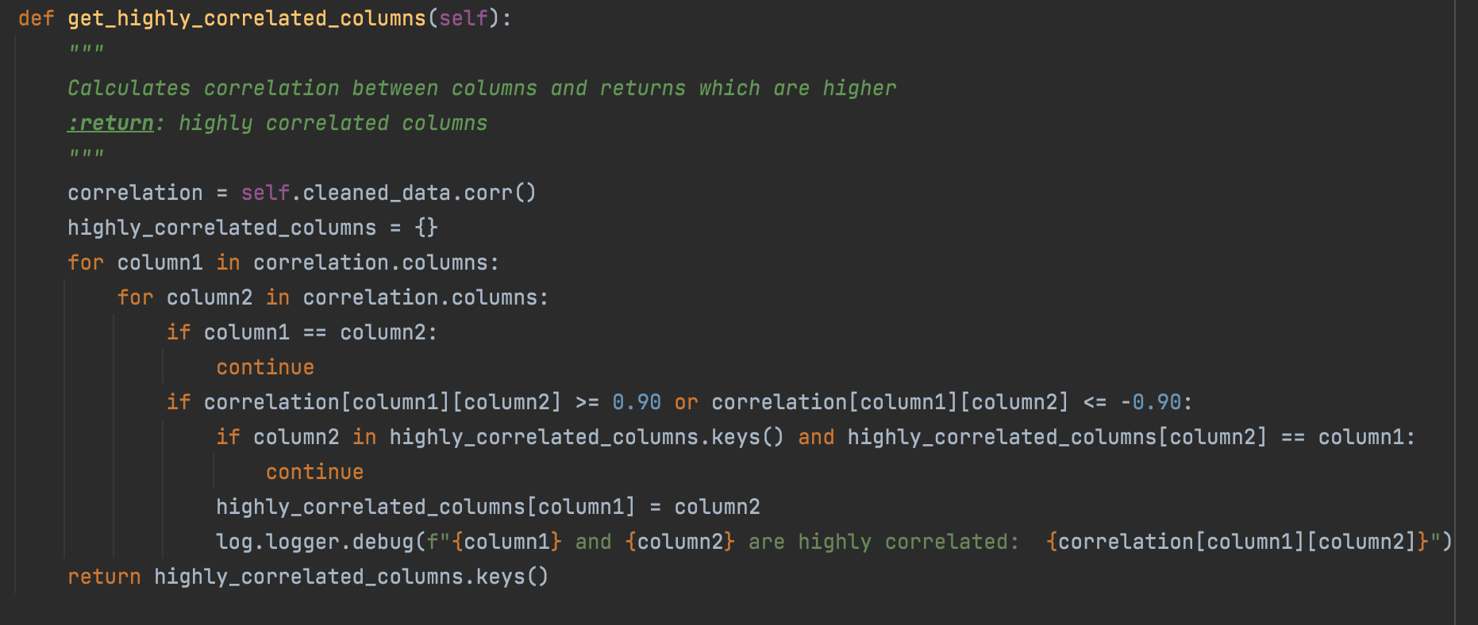
6b. Important Methods

Slide 20
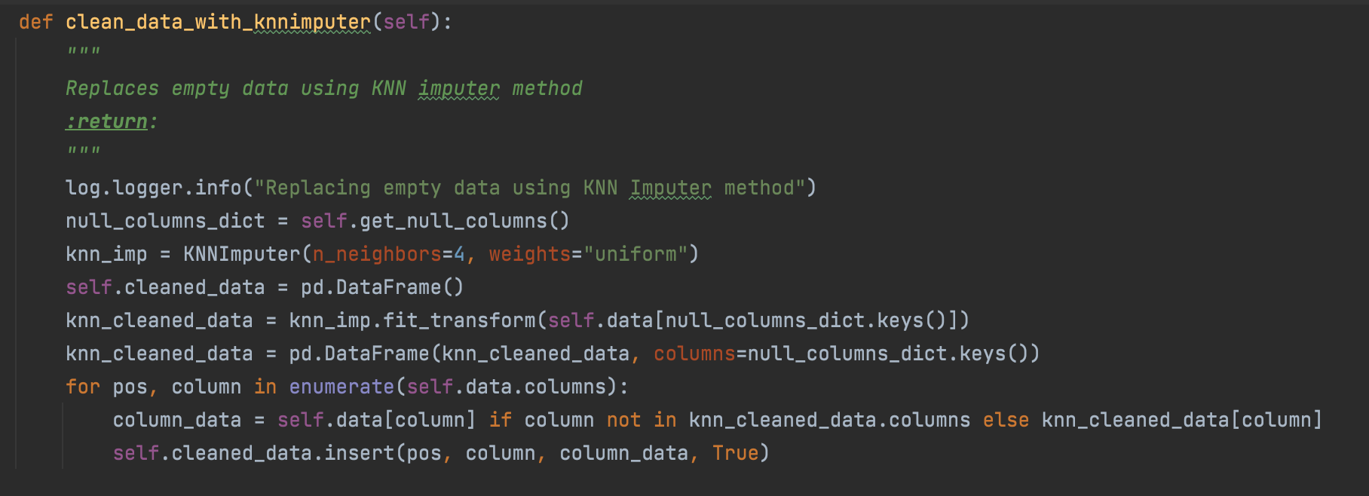
6b. Important Methods

Slide 21
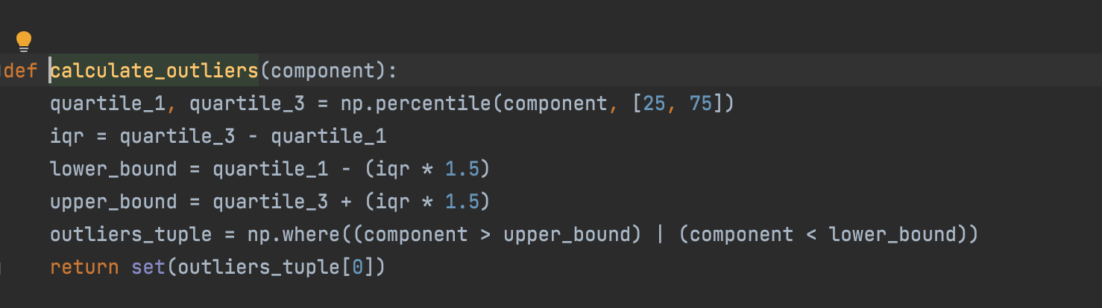
6b. Important Methods

Slide 22
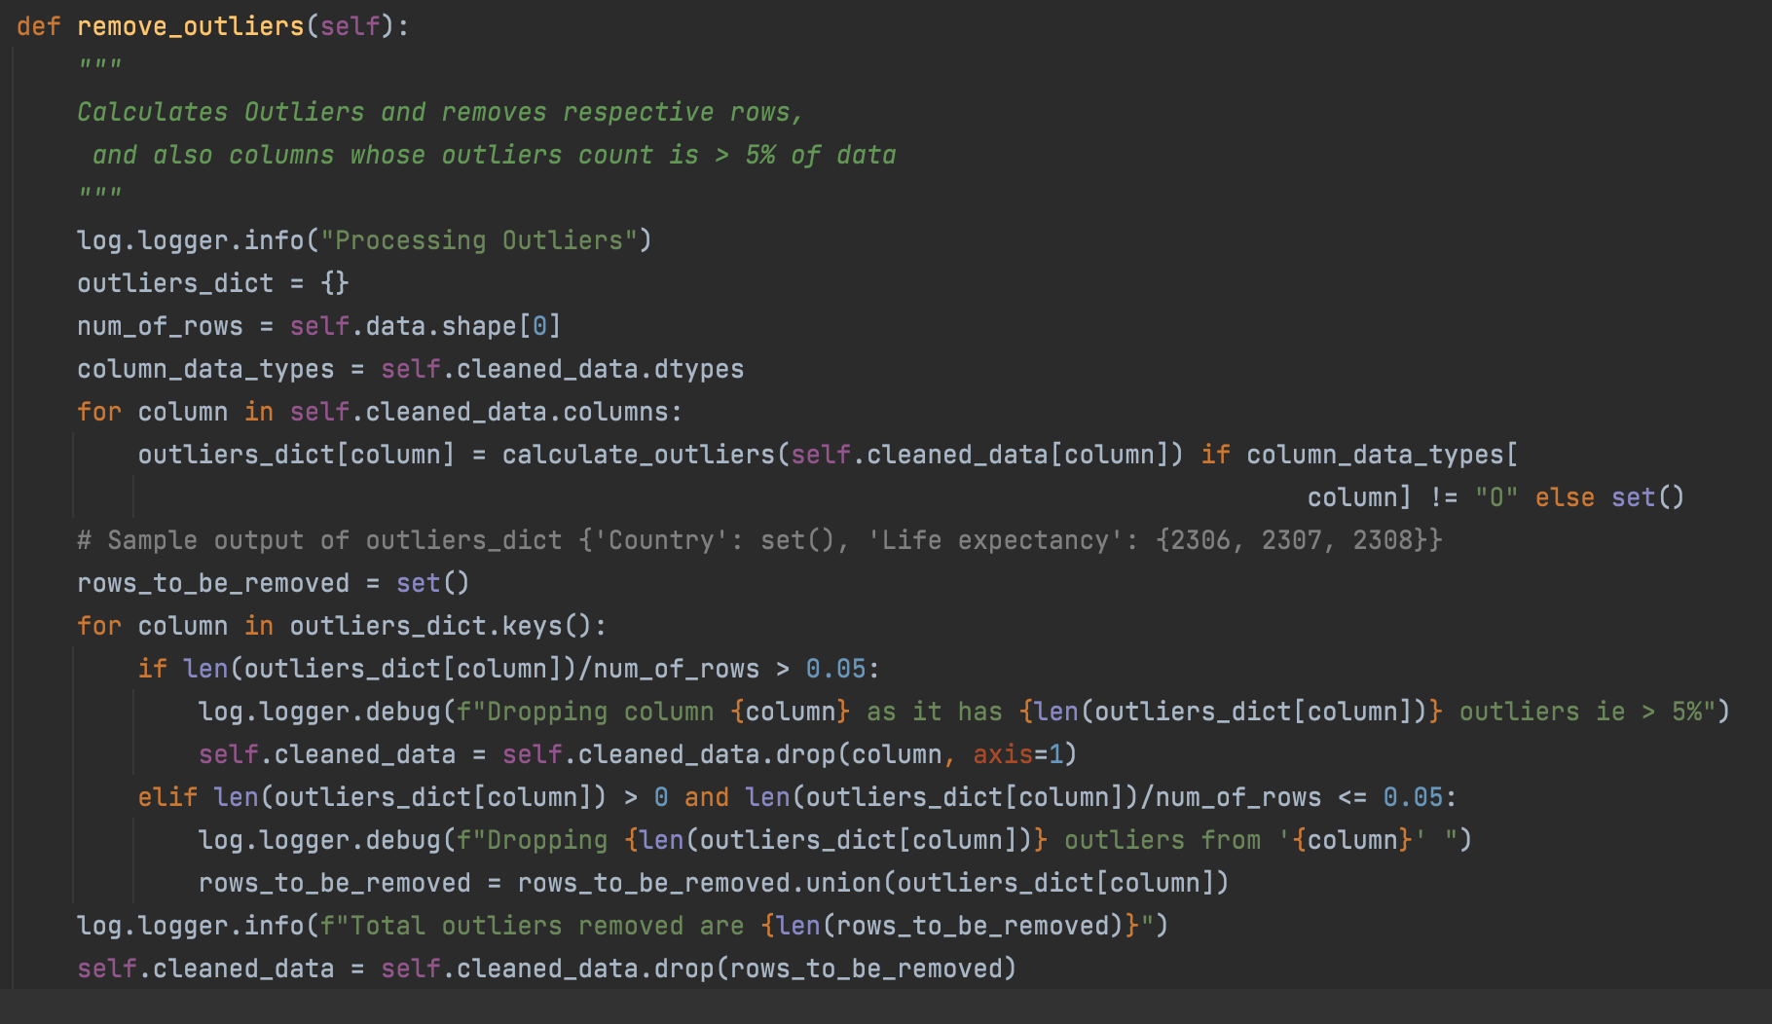

Slide 23
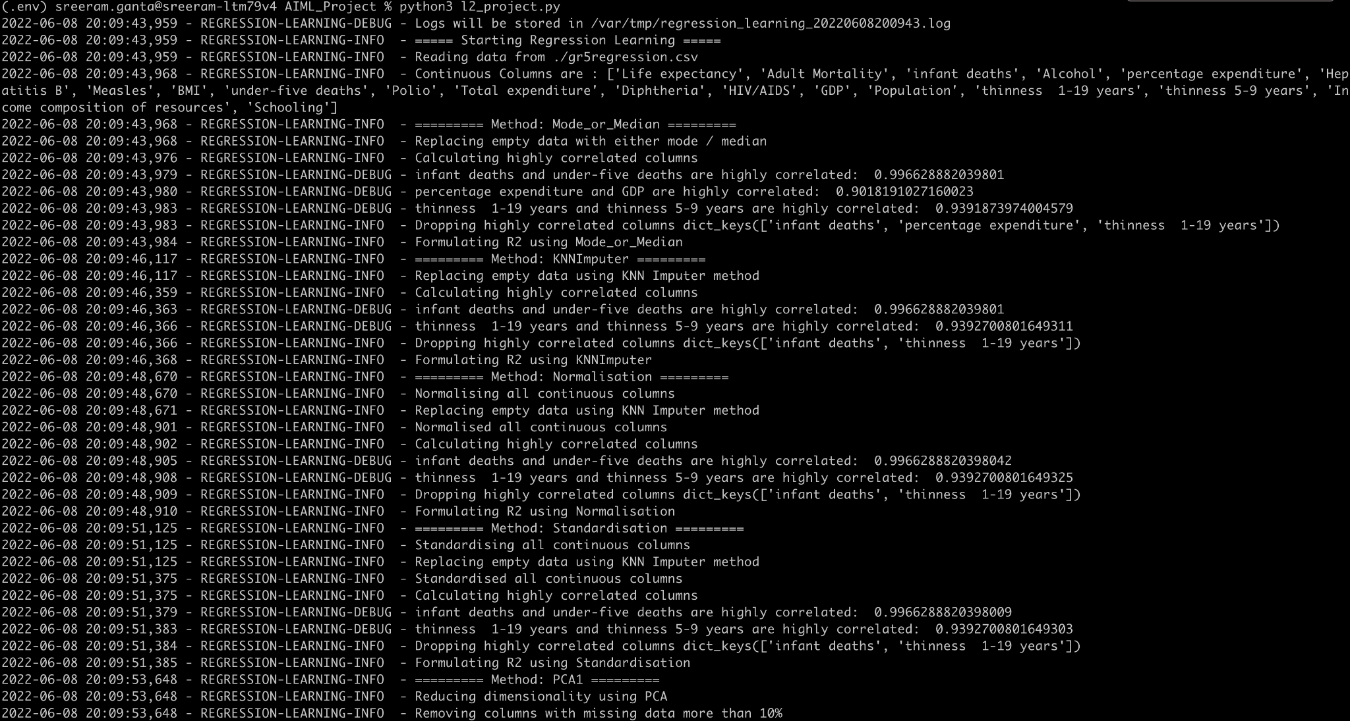

Slide 24
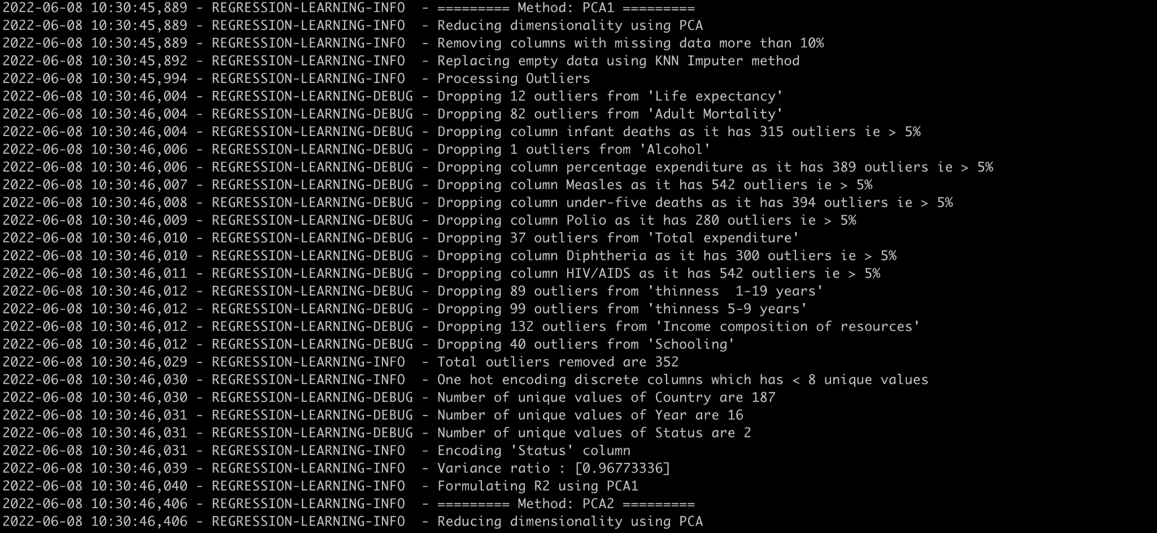

Slide 25
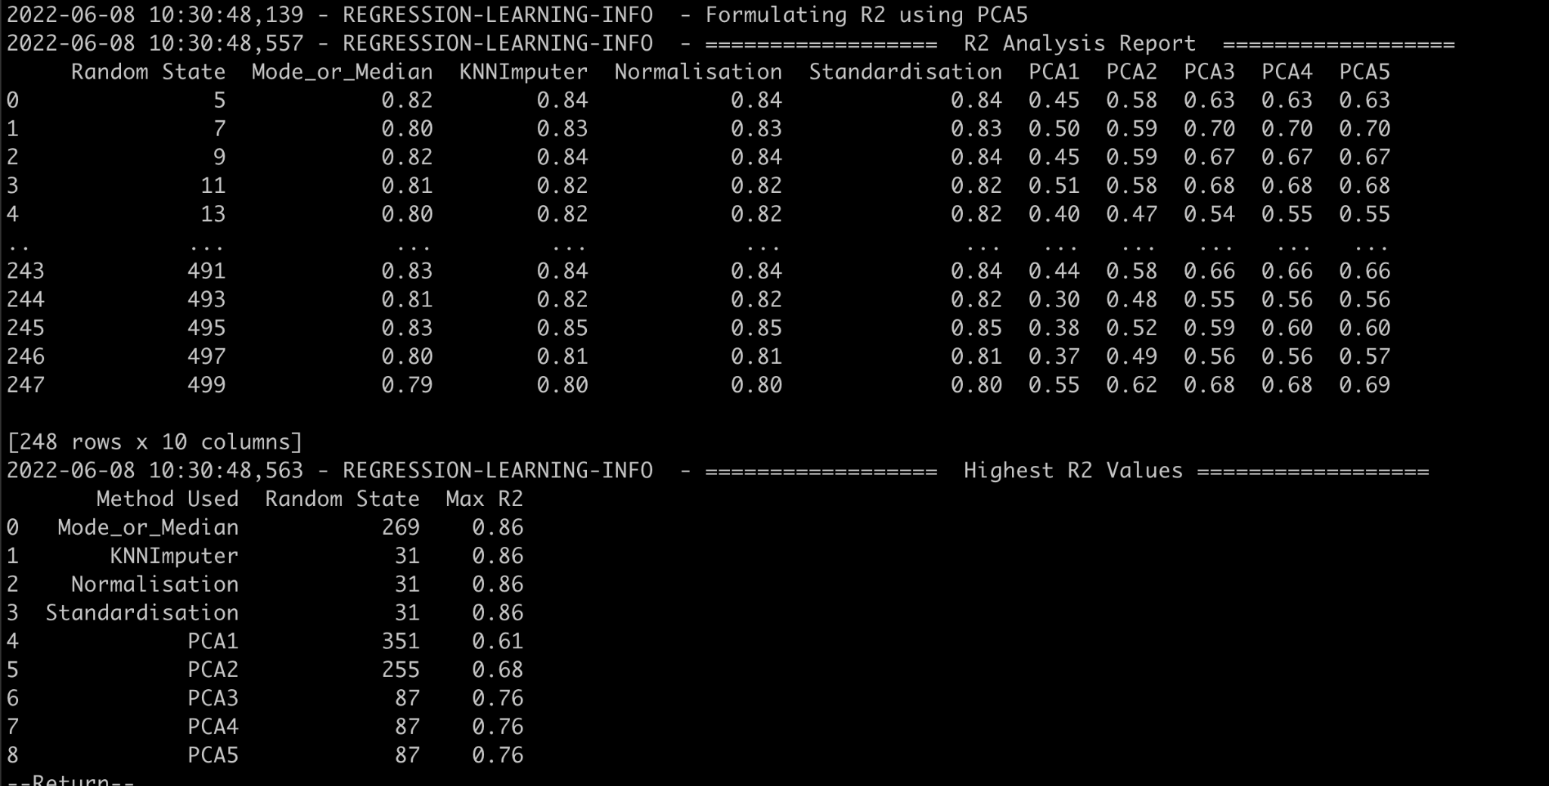
6c. R2 Report

Slide 26
Our Learnings
KNNImputer / Normalisation / Standardisation alone gets effective R2 score. These can be used when dealing with less columns
Reducing dimensions using PCA might affect R2 score
Got negative R2 score in PCA1 method, this occurs when data has more outliers columns.
Negative R2 also comes when we delete more outliers rows from data.
Figured out list of config parameters which affect the R2 score for each method

Slide 27
Future Scopes
Optimise script to support all kinds of data
Have a config file as an input to the script
Create different tabular data for different config parameters
Code Reference: https://github.com/sreeram514/AIML_Project

Slide 28
THANK YOU

